Slide 1
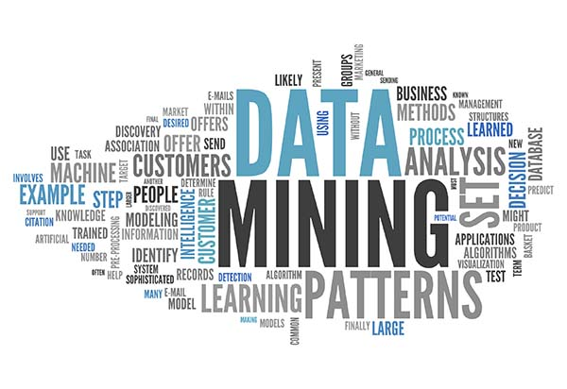
Market Basket Analysis and Association Rule Mining
Dr. Liang (Leon) Chen
Picture Source: http://jalk.dvrlists.com/data-mining
Notes:
Hello everyone, welcome to Week 10. In the past two weeks, we learnt clustering techniques. This week, we are going to learn another unsupervised data mining technique– Association rule mining, which is frequently used in market basket analysis.

Slide 2
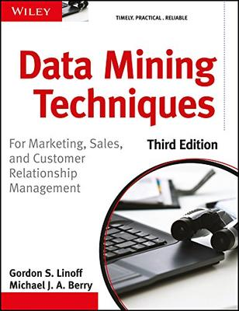
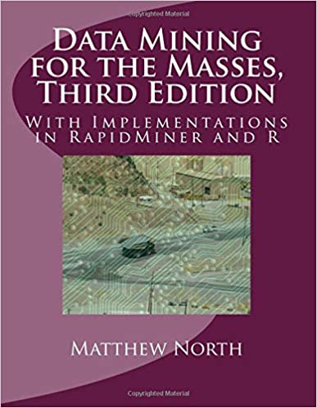
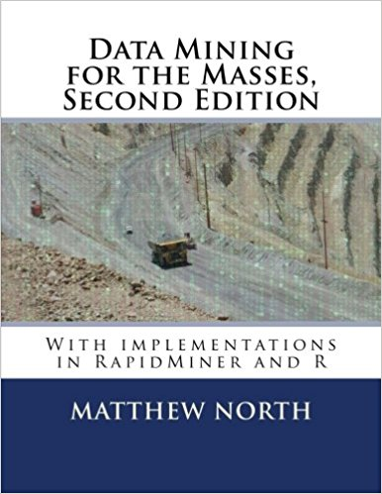
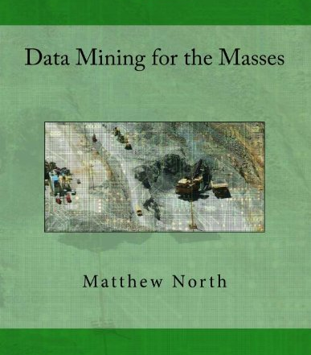
Recommended Readings
Chapter 15, Linoff and Berry Book.
Chapter 5, Matthew A. North Book.

Slide 3
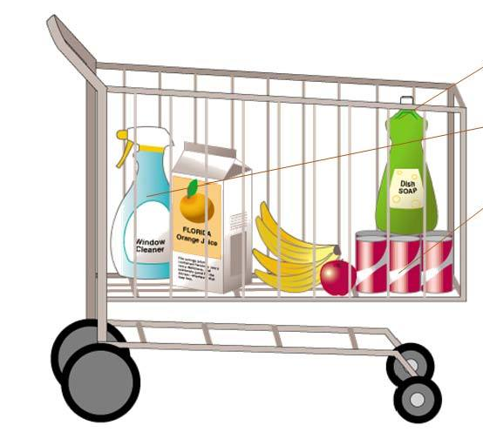
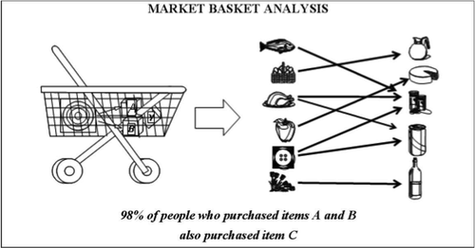
Learning Objectives
What is market basket analysis?
What is association rule?
Support and confidence of association rules
Association rule mining process

Slide 4
What can be inferred?
I purchase diapers
I purchase a new car
I purchase OTC cough medicine
I purchase a prescription medication
I don’t show up for class

Slide 5

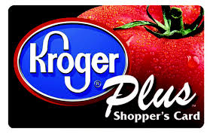

Market Basket Analysis
Retail – each customer purchases different set of products, different quantities, different times or locations
MBA (Market Basket Analysis) uses this information to:
Identify who customers are (not by name)
Understand why they make certain purchases
Gain insight about its merchandise (products):
Fast and slow movers
Products which are purchased together
Products which might benefit from promotion
Take action:
Store layouts
Which products to put on specials, promote, coupons…
Combining all of this with a customer loyalty card it
becomes even more valuable
Notes:
MBA can be conducted by traditional data analysis and data mining techniques. Let’s briefly introduce the traditional data analysis first and then focus on data mining approach, that is association rule mining.

Slide 6
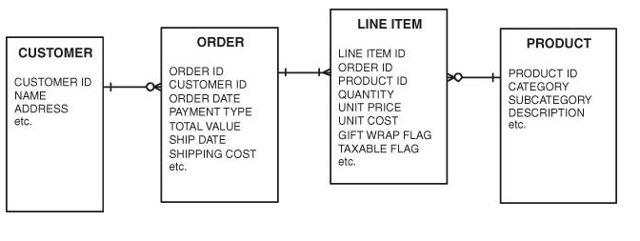
Typical Data Structure (Relational Database)
Lots of questions can be answered
Avg # of orders/customer
Avg # unique items/order
Avg # of items/order
For a product
What % of customers have purchased
Avg # orders/customer include it
Avg quantity of it purchased/order
Etc…
Entity Relationship (ER) diagram
Transaction Data
Visualization is extremely helpful…next slide
Notes:
Let’s take a look at typical data structure first.
This ER diagram shows the relationship among tables of your transaction data.
We can write a query to get these answer, which are also important for market basket analysis, especially when we visualize those results. I will show you two examples in the next slide.

Slide 7
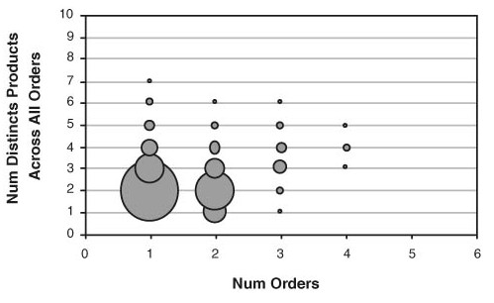
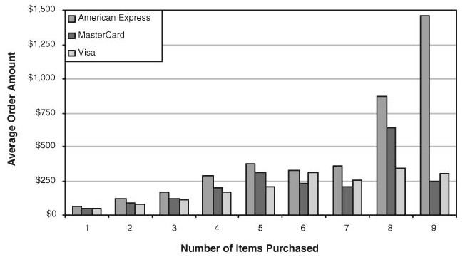
Sales Order Characteristics
Notes:
The first diagram can show you loyal customers
When a customer buys nine items, American Express cardholders pay much more than the other two types of credit cardholders.
We can conduct many business actions based on these results.

Slide 8
Sales Order Characteristics
Did the order use gift wrap?
Billing address same as Shipping address?
Did purchaser accept/decline a cross-sell?
What is the most common item found on a one-item order?
What is the most common item found on a multi-item order?
What is the most common item for repeat customer purchases?
How has ordering of an item changed over time?
How does the ordering of an item vary geographically?
Yada…yada…yada…
Notes:
We can do a lot of different types of analysis to find some other valuable information.
We might use bundle, promotion; for multiple-item order, r reduce one item’s price to attract customers to buy other relevant items.
There are a lot of analysis we can do even without data mining techniques.

Slide 9

Association Rules
DM technique most closely allied with Market Basket Analysis
AR can be automatically generated
AR represent patterns in the data without a
specified target variable
Good example of undirected data mining
Whether patterns make sense is up to human decisions
Notes:
We use data mining to identify interesting rules or patterns;

Slide 10

Association Rules
Rule: If X then Y.
If a customer purchases bread, then the customer also purchases milk.
{Bread} → {Milk}
If a customer purchases bread and milk, then the customer also purchases diapers.
{Bread, Milk} → {Diapers}

Slide 11
Usefulness of Rules
Wal-Mart customers who purchase Barbie dolls have a 60% likelihood of also purchasing one of three types of candy bars [Forbes, Sept 8, 1997]
Customers who purchase maintenance agreements are very likely to purchase large appliances
When a new hardware store opens, one of the most commonly sold items is toilet bowl cleaners
So what…

Slide 12

Usefulness of Rules
Association rule types:
Actionable Rules – contain high-quality,
actionable information
Trivial Rules – information already well- known by those familiar with the business
Inexplicable Rules – no explanation and do
not suggest action
Trivial and Inexplicable Rules occur most often

Slide 13
How Good is an Association Rule?
Rule: {X} → {Y}
Rule Support – Fraction of transactions that contain both X and Y out of all the transactions
– Count{X,Y}/TotalCount
A rule needs a support of several hundred transactions before it can be considered statistically significant
Rule Confidence – Fraction of transactions containing X and Y out of all the transactions that contain X.
– Count{X,Y}/Count{X}

Slide 14
How Good is an Association Rule?
Customer | Items Purchased
1 | OJ, soda
2 | Milk, OJ, window cleaner
3 | OJ, detergent, soda
4 | OJ, detergent, soda
5 | Window cleaner, soda
POS Transactions
Co-occurrence of Products
 | OJ | Window cleaner | Milk | Soda | Detergent
OJ | 4 | 1 | 1 | 3 | 2
Window cleaner | 1 | 2 | 1 | 1 | 0
Milk | 1 | 1 | 1 | 0 | 0
Soda | 3 | 1 | 0 | 4 | 2
Detergent | 2 | 0 | 0 | 2 | 2
OJ=orange juice

Slide 15
How Good is an Association Rule?
 |  |  | OJ | Window cleaner | Milk | Soda | Detergent
 |  | OJ | 4 | 1 | 1 | 3 | 2
 |  | Window cleaner | 1 | 2 | 1 | 1 | 0
 |  | Milk | 1 | 1 | 1 | 0 | 0
 |  | Soda | 3 | 1 | 0 | 4 | 2
 |  | Detergent | 2 | 0 | 0 | 2 | 2
Simple patterns:
OJ and soda are more likely purchased together than any other two items
Detergent is never purchased with milk or window cleaner
Milk is never purchased with soda or detergent

Slide 16
How Good is an Association Rule?
 |  | Customer | Items Purchased
 |  | 1 | OJ, soda
 |  | 2 | Milk, OJ, window cleaner
 |  | 3 | OJ, detergent, soda
 |  | 4 | OJ, detergent, soda
 |  | 5 | Window cleaner, soda
POS Transactions
What is the support and confidence for this rule (Soda->OJ):
If a customer purchases soda, then customer also purchases OJ
Support: 3 out of 5 purchases include both Soda and OJ, so 60%
Confidence: 3 out of 4 soda purchases also include OJ, so 75%
What about the support and confidence of this rule reversed (OJ-
>Soda)?
Support is the same as above, 60%
Confidence: 3 out of 4 OJ purchases also include soda, so 75%

Slide 17
Association Rule Mining
Given a set of transactions, the goal of association rule mining is to find all rules having:
Rule Support >= [Minimum Support Threshold]
Rule Confidence >= [Minimum Confidence Threshold]
A rule that meets both these thresholds is called a strong rule.

Slide 18
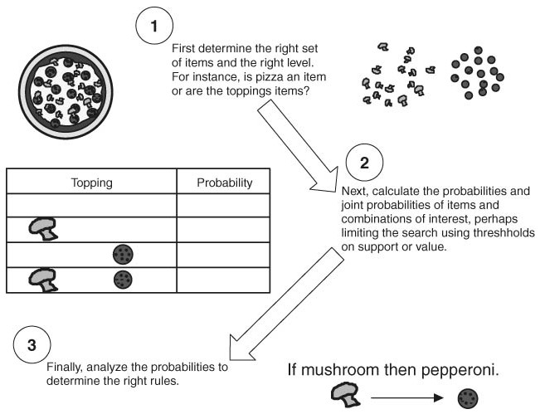
Association Rule Mining Process
Choosing the right set of items
Generating rules by deciphering the counts in the co-occurrence matrix
Generate frequent itemsets based on support threshold value.
Filter itemsets based on confidence threshold value.
Overcoming the practical limits imposed by thousands or tens of thousands of unique items
Notes:
This is the Process of Association Rule Mining. First of all, we should choose the right set of items; this is kind of considered as data preprocessing. Suppose that you have a transactional database, which includes millions of orders and ten thousand items. You are not necessary be interested in all those items. If you are only interested in food or electronics, you can only select a subset of all items. If you are interested in the relationship among all product categories, you can replace all the product names with their category names. All the food items are replaced by food; all electronic items are replaced with electronics. This is the first step of association rule mining.
Then, we will generate rules by the counts in the co-occurrence matrix. First, we generate frequent item-sets based on support threshold value. For instance, you might use 10% as the threshold value, and then you will generate all the itemsets which occur more than 10% of the transaction orders. Then, you will filter out item-sets based on the confidence threshold value.
This will be considered as two steps (operators) in RapidMiner. This is different from other Data mining processes we have learned before. For example, in decision tree process, we only have one operator “decision tree”. However, for this process, we have two steps: the first one generates frequent itemsets and the other one creates the association rule based on the confidence threshold value. I will show you how to do this in our lab tutorial.
Lastly, we will consider how to overcome the practical limits in the next few slides.

Slide 19
Frequent Itemset Generation
null
A
B
C
D
E
AB
AC
AD
AE
BC
BD
BE
CD
CE
DE
ABC
ABD
ABE
ACD
ACE
ADE
BCD
BCE
BDE
CDE
ABCD
ABCE
ABDE
ACDE
BCDE
ABCDE
Given d items, there are 2^{d} possible candidate itemsets
Fast Food Restaurant…could have 100 items on its menu
How many combinations are there with 3 different menu items? 161,700 !
Supermarket…10,000 or more unique items
50 million 2-item combinations; 100 billion 3-item combinations
The number of transactions in a given time-period could also be huge (hence expensive/impossible to analyze)
Notes:
Given d items, there are 2^{d} possible candidate itemsets. I will show you how complex it is.
Suppose that we have five unique products, we are going to have 32 intemsets, as shown in this picture.
For Fast Food Restaurant…could have 100 items on its menu: How many combinations are there with 3 different menu items? 161,700 !
For the supermarket with 10K unique items, there are 50 million 2-item combinations and 100 billion 3-item combinations. That’s a huge dataset. It is computationally expensive and even impossible. It is impossible to handle such a big matrix.
We have a few ways to address this problem. In the next two slides, I will introduce three common approaches.

Slide 20
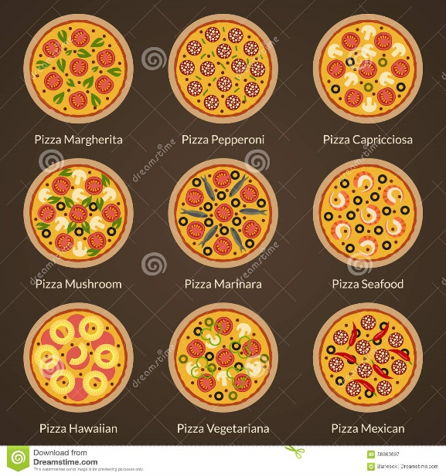
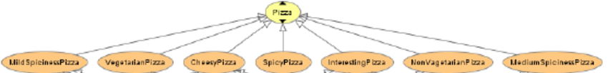
Overcoming Practical Limits for Association Rules
Approach 1
Generate co-occurrence matrix for single items…”if OJ then soda”
Generate co-occurrence matrix for two items…”if OJ and Milk then soda”
Generate co-occurrence matrix for three items…”if OJ and Milk and Window Cleaner” then soda
Etc…
Approach 2:Use product hierarchies (groupings) instead of individual items
Example: pizza
Notes:
If we have 100 items, we will have a 100 by 100 matrix.
Then, we generate co-occurrence matrix for two items: if we have 100 items, we will have 10K (100*100) columns and 100 rows.
Then, we generate co-occurrence matrix for three items. We will have 1million (100*100*100) columns and 100 rows.
By using this technique, we will reduce the number of columns and rows. And we reduce the complexity.
This is the first technique we can use.
Use of product hierarchies (groupings) helps address this common issue
For example, we have different types of pizzas, peperoni, cheese, veggie. We try to reduce the number of columns/rows, so in stead of using individual pizzas, we just pizza (the group/hierarchy) to represent all types of pizzas.

Slide 21
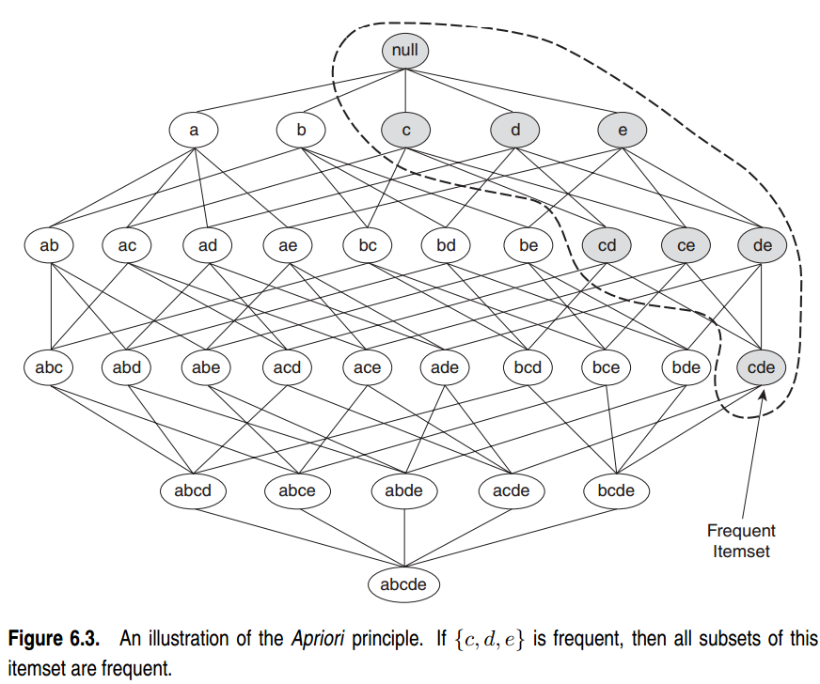
Apriori Principle
If an intemset is frequent, then all of its subsets must also frequent;
if an intemset is infrequent, then all of its supersets must be infrequent too.
subset
itemset
superset
Hastie, R. Tibshirani and J. Friedman, The Elements of Statistical Learning, Second Edition, Springer. P. 334

Slide 22
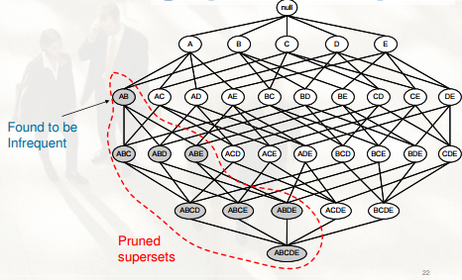
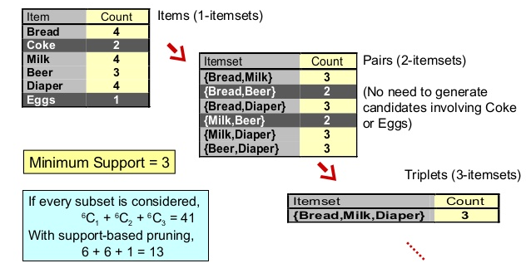
Overcoming Practical Limits for Association Rules
Approach 3: Apriori principle
If itemset AB is considered as frequent, then all its subsets (A, B) are frequent.
If itemset A is not frequent, all itemsets (AB, ABC, etc.) including A won’t be frequent
If itemset AB is not considered as frequent, all itemsets (ABC, ABD, etc) that includes AB will not be considered as frequent.
Min count =3
Notes:
Priori principle: the frequency of two items is based on that of one item; the three item frequency is based on the two-item frequencies. If a single-item is not frequent, all itemsets includes this item will not be frequent. For example, if product A….
This will help us significantly reduce the complexity and computation cost.

Slide 23
Next Class
Topic: Introduction to Text Mining
Readings
Chapter 21, Linoffand Berry Book.
Chapter 12, Matthew A. North Book
Week 10 Lab
Group Project: Submit your project proposal by Sunday.

